Slide 1
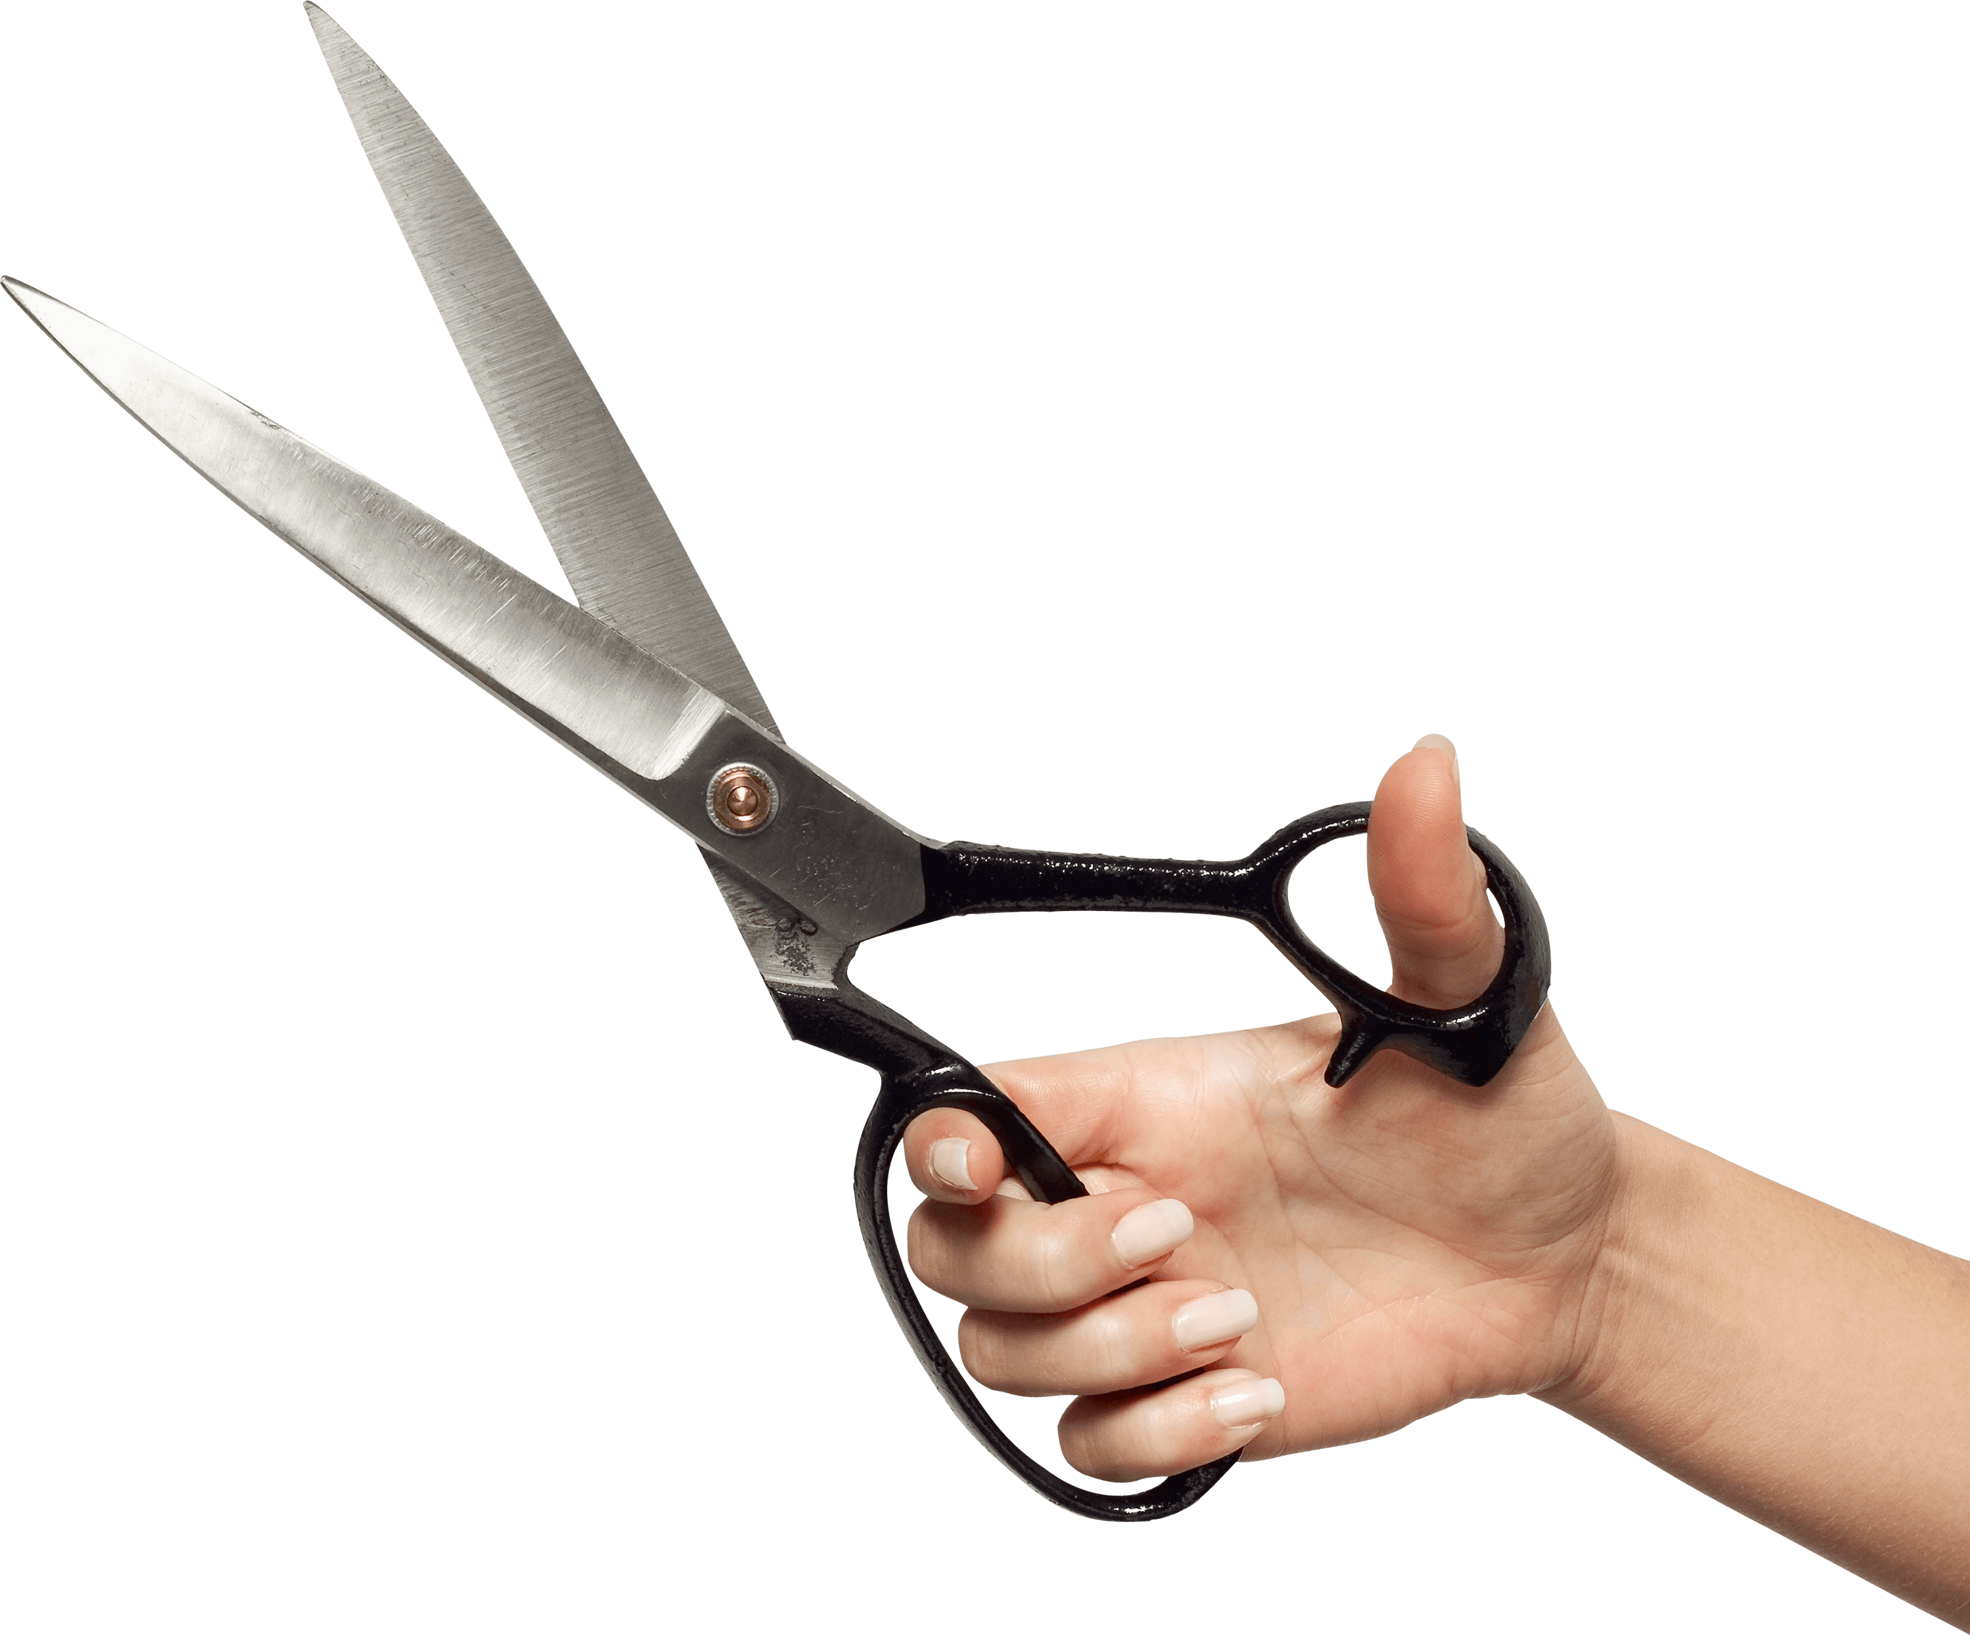
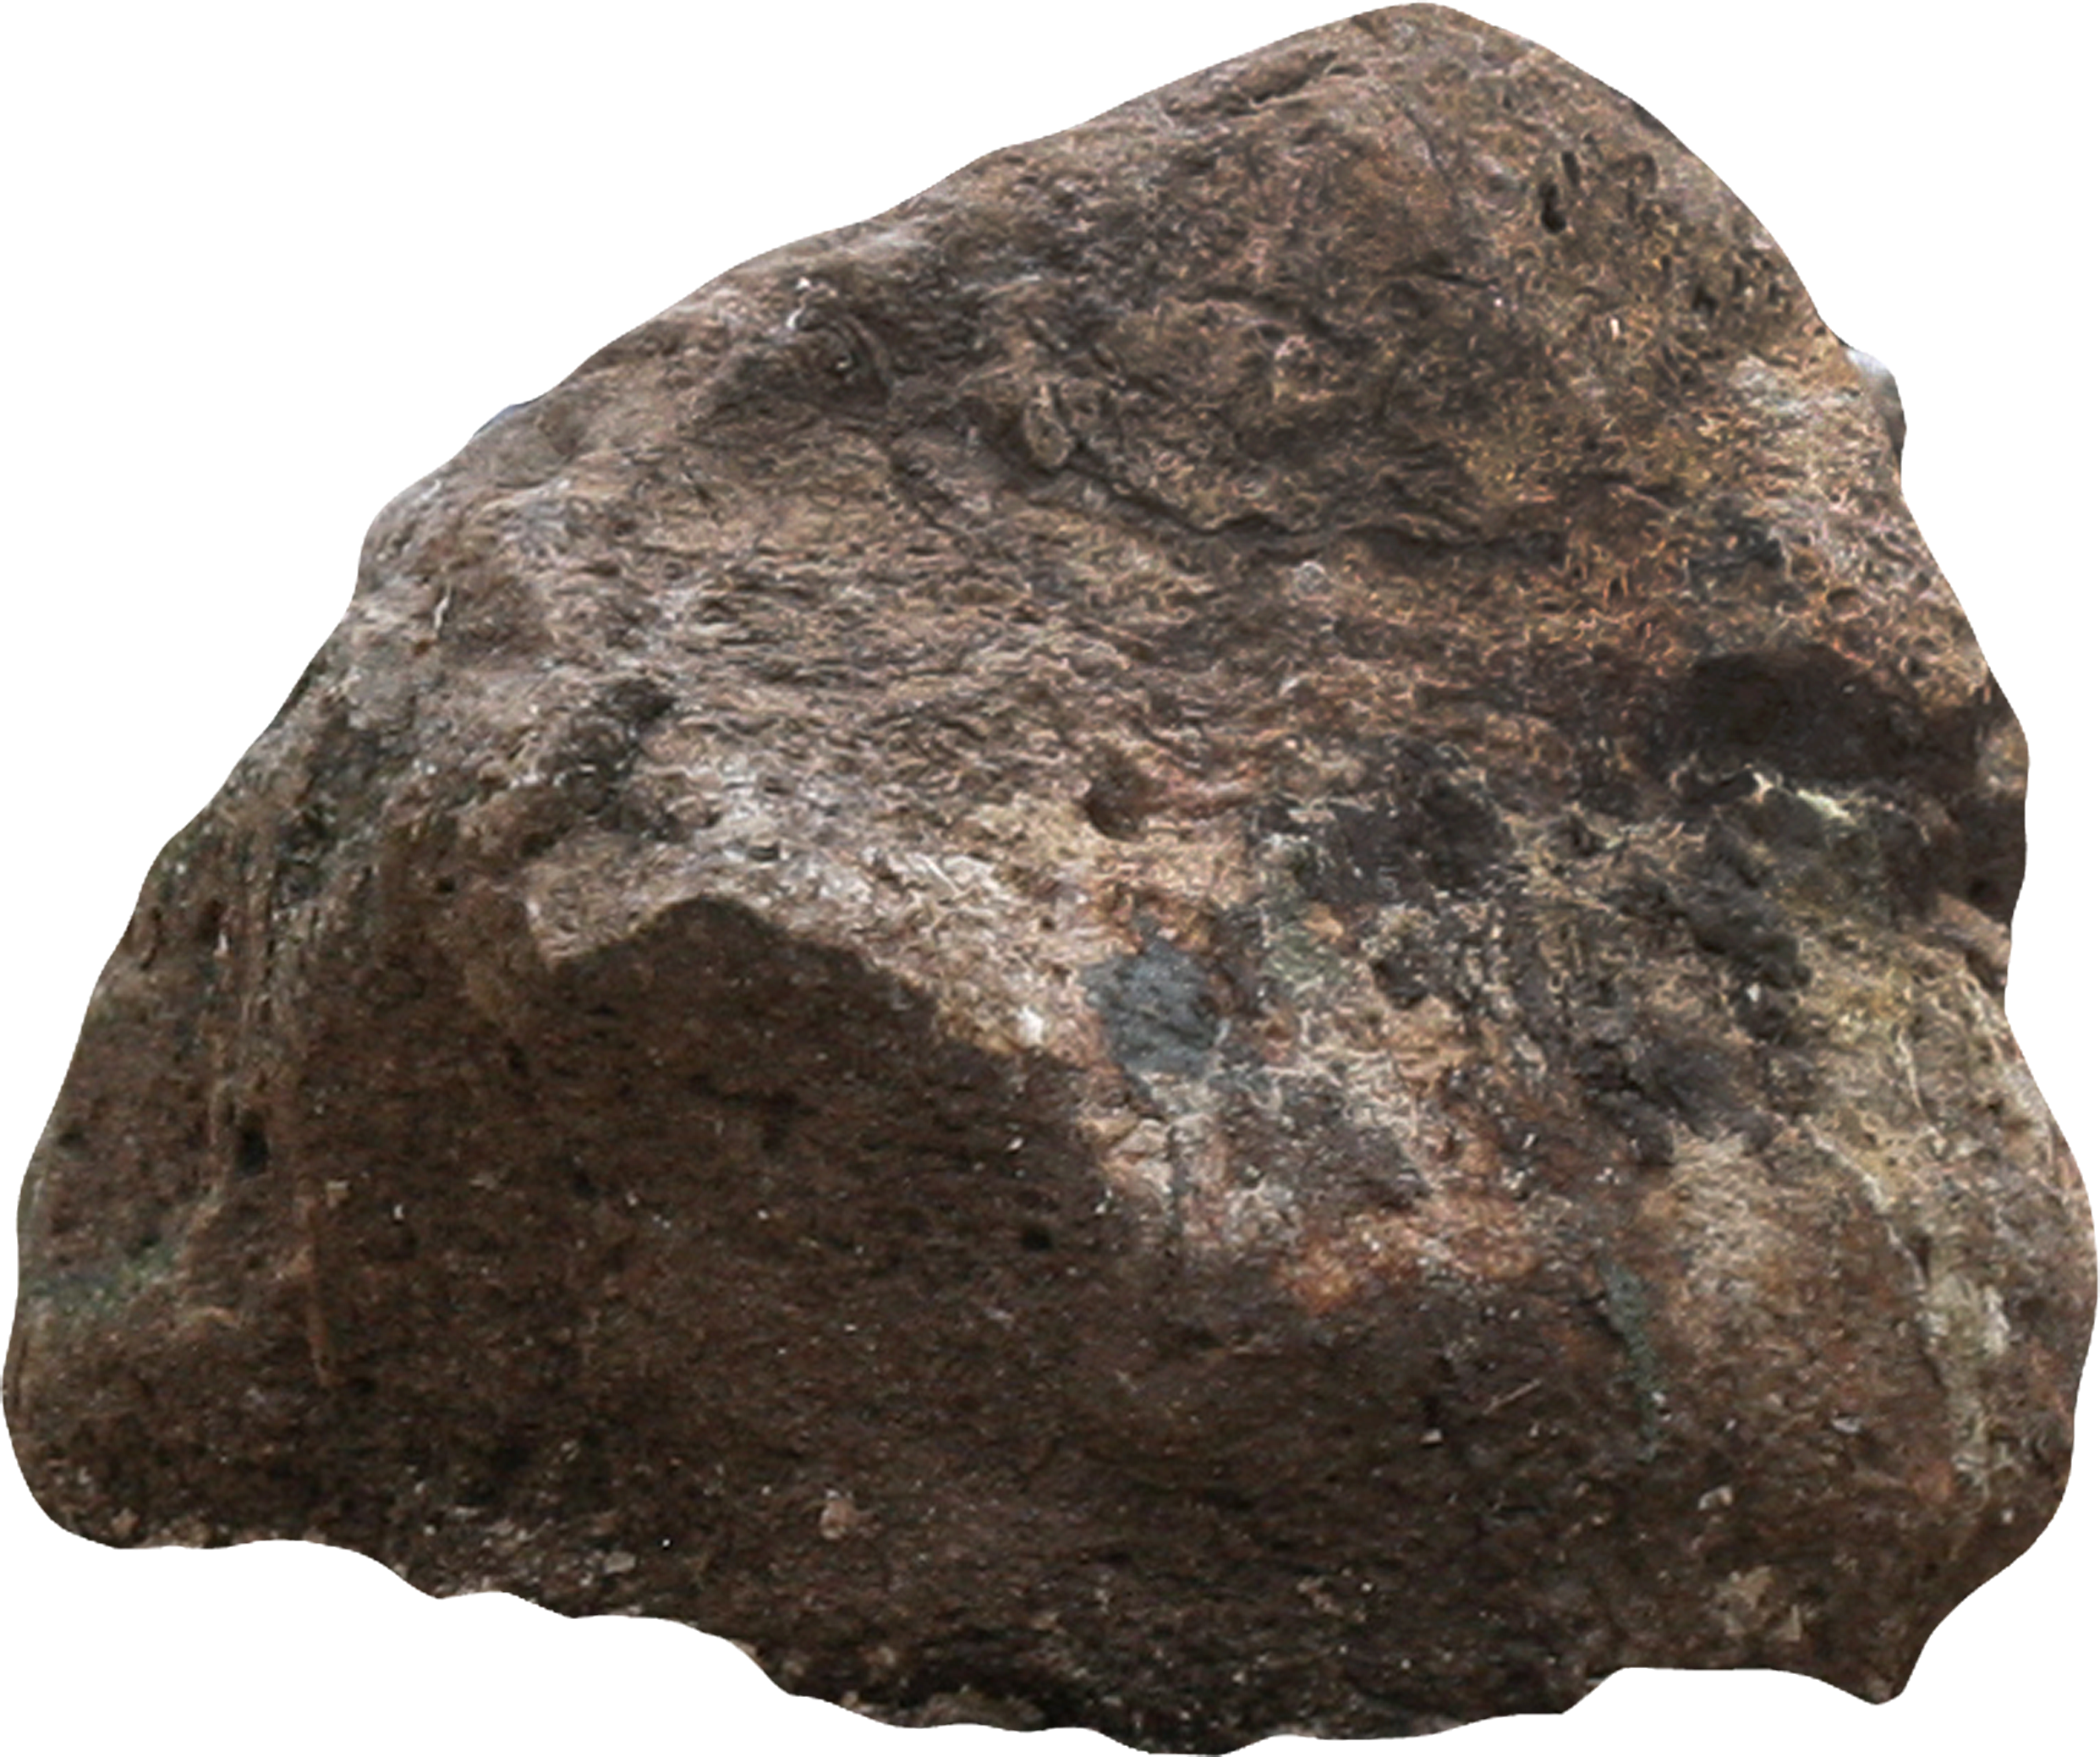
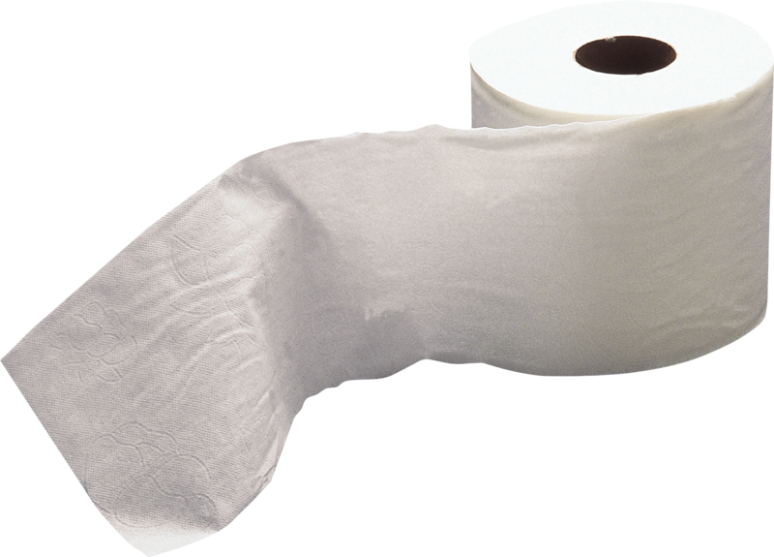
The Dark Chocolates Rock, Paper, Scissors Project
And the process of the creation

Slide 2
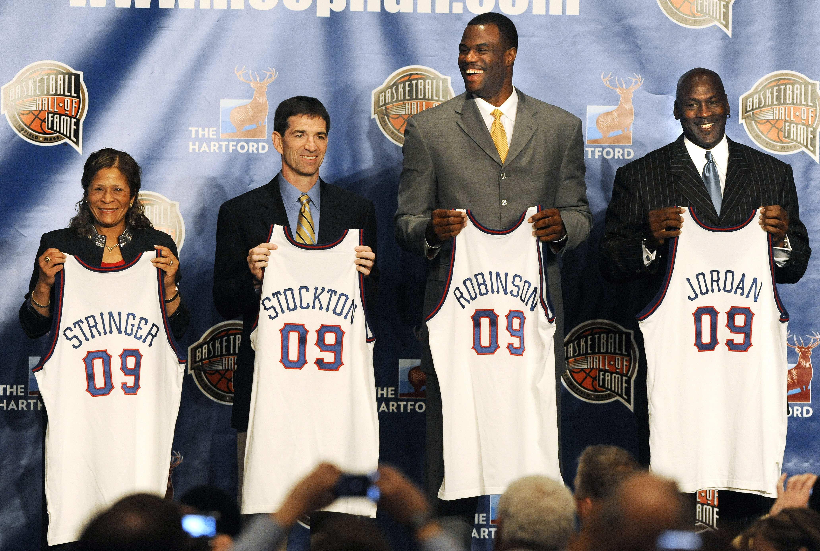
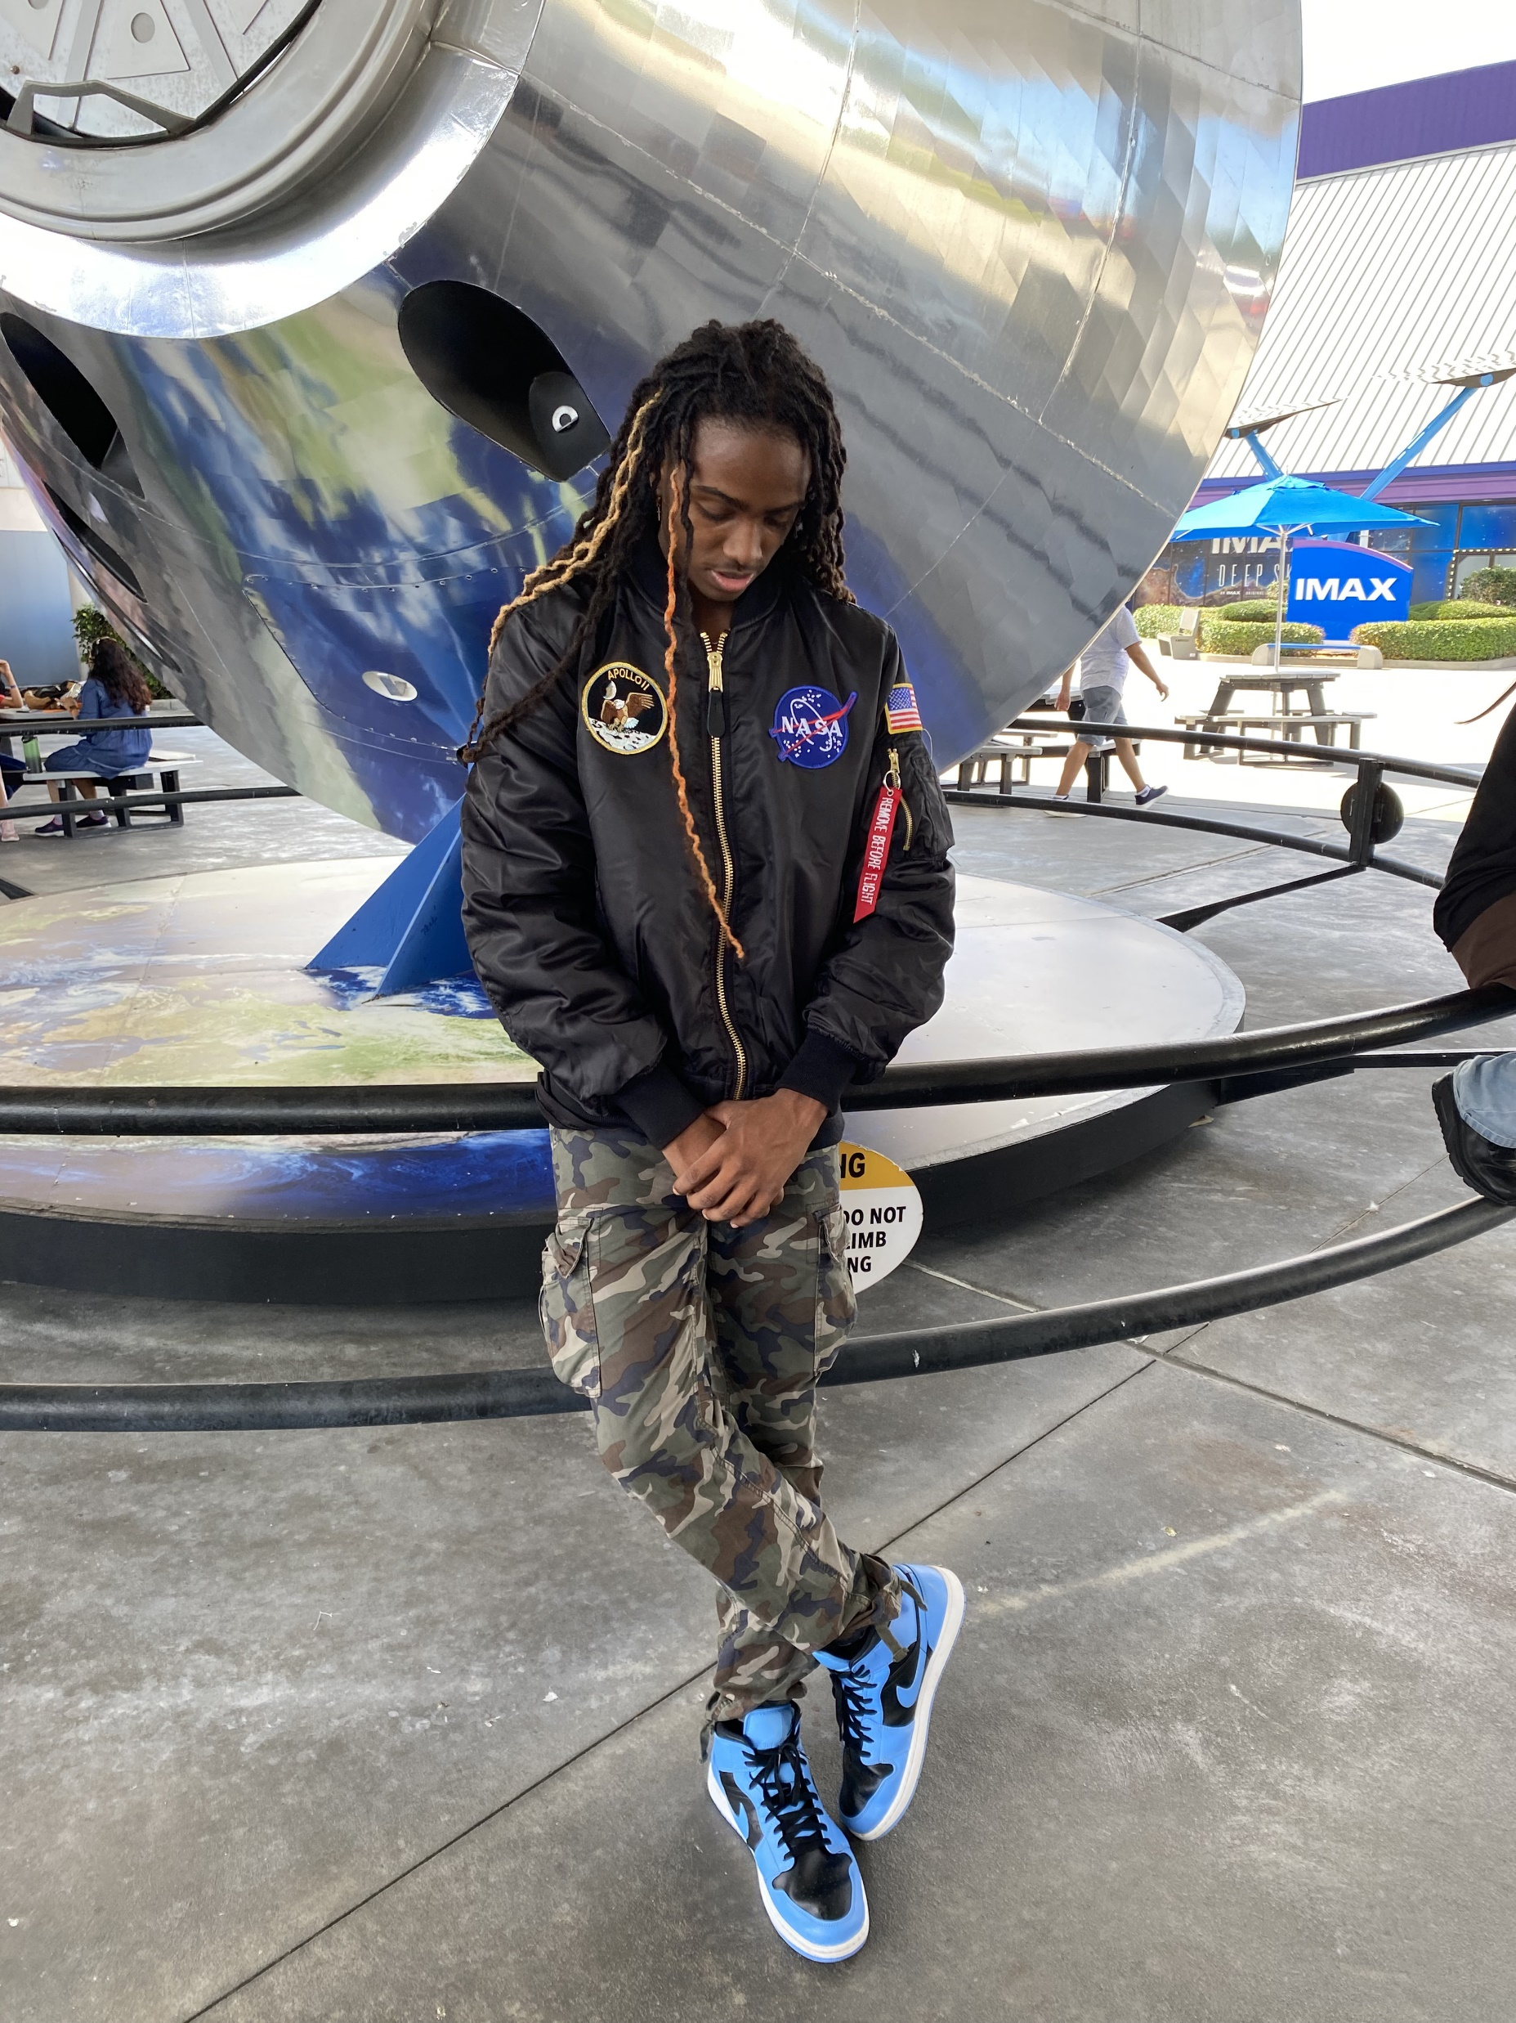
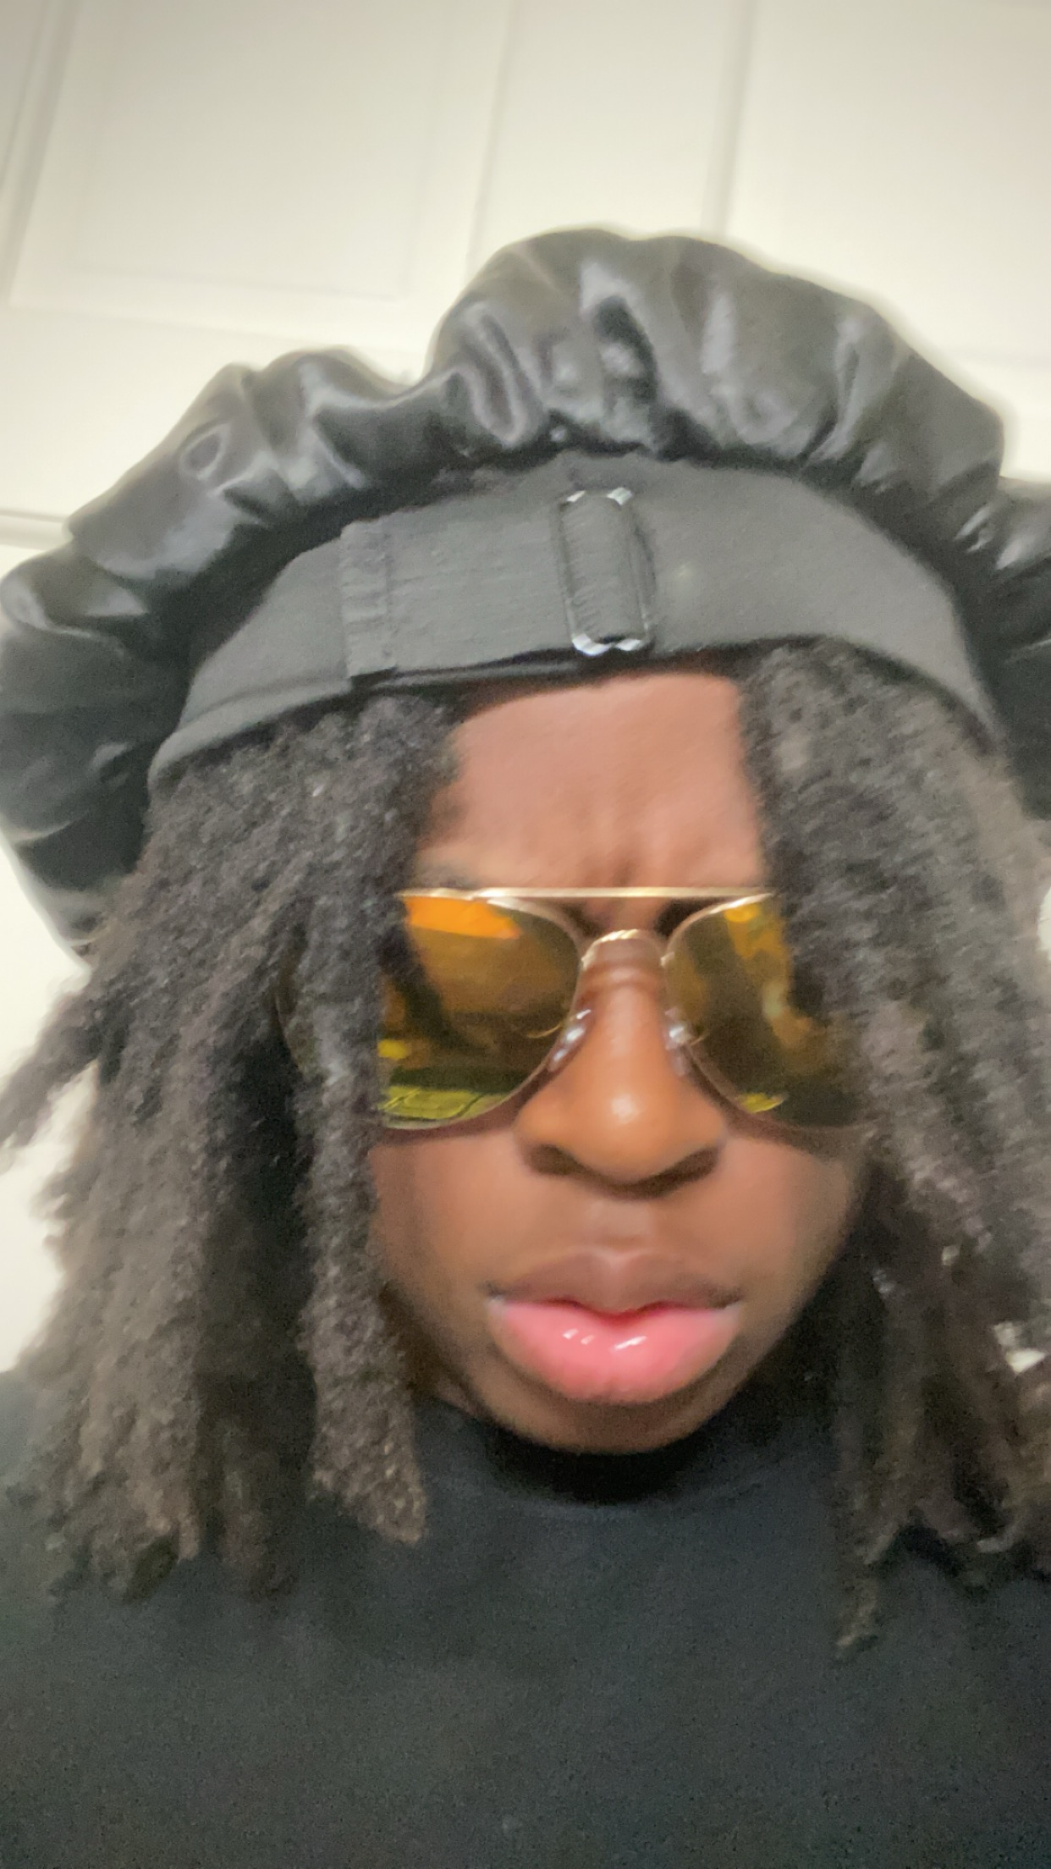
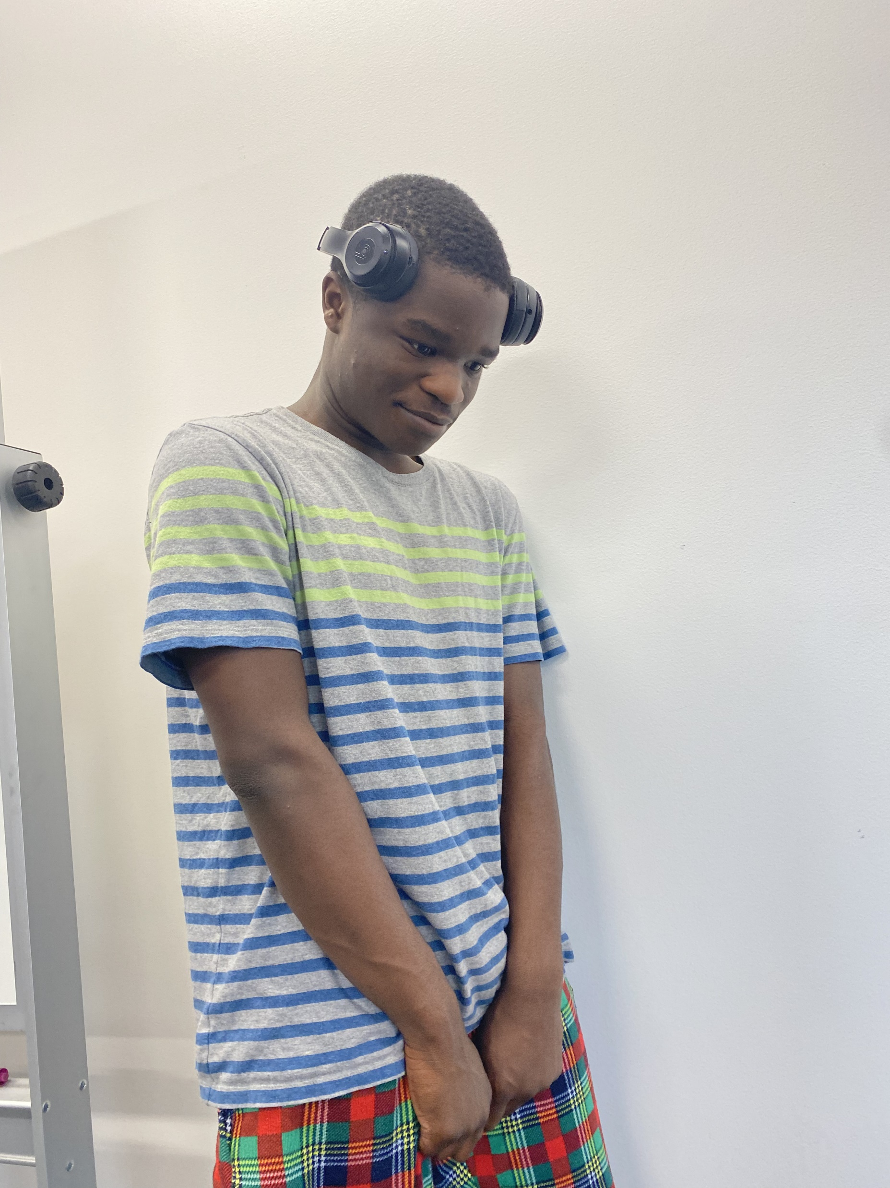
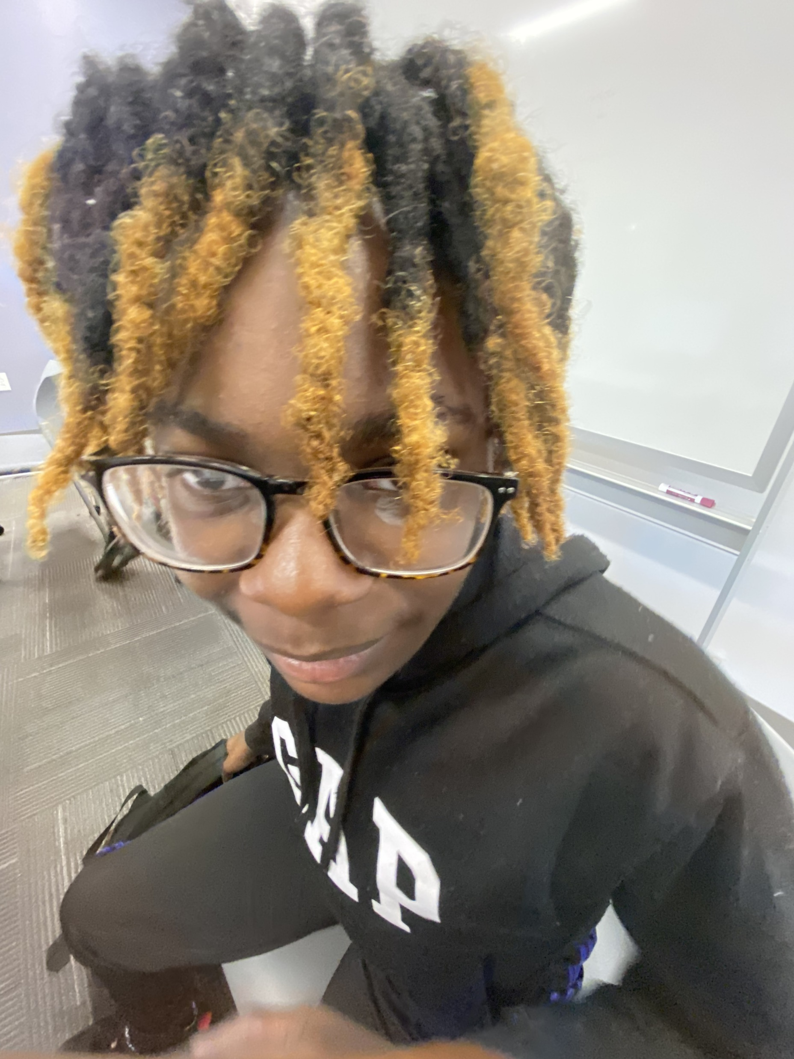
OUR HEAD STAFF
Main Scripter
presentation maker
Hand model
Hand model

Slide 3
THE STATISTICS
Objective and model
The objective of this project to is develop a ai that can Recognize the different hand movements such as Rock ,Paper, and Scissors.
Methodology
ACCURACY
Dataset
The method we used for this project was mainly trial and error. We kept doing it until we got to a point we were satisfied with.
The accuracy of the rps Project at first was 74%. With the use of chat gpt, we strived for a higher accuracy and brought it up to a 94%
The data we gained took bit to acquire Because we had to train our model to pose correctly. We also found out everyone plays Rock Paper Scissors different ways with different movements. The data we did acquire though was satisfactory. We feel as our code nearly perfect.

Slide 4
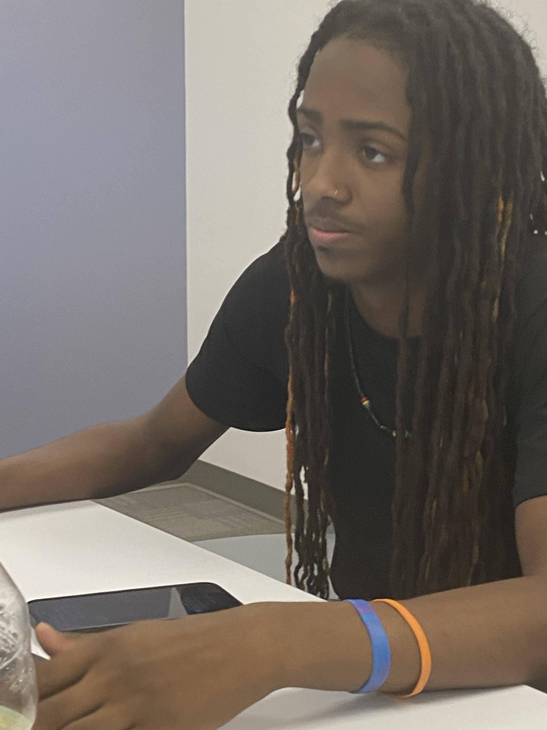
Our Staff was hard at work
We spent countless minutes stressing over the code not working.

Slide 5
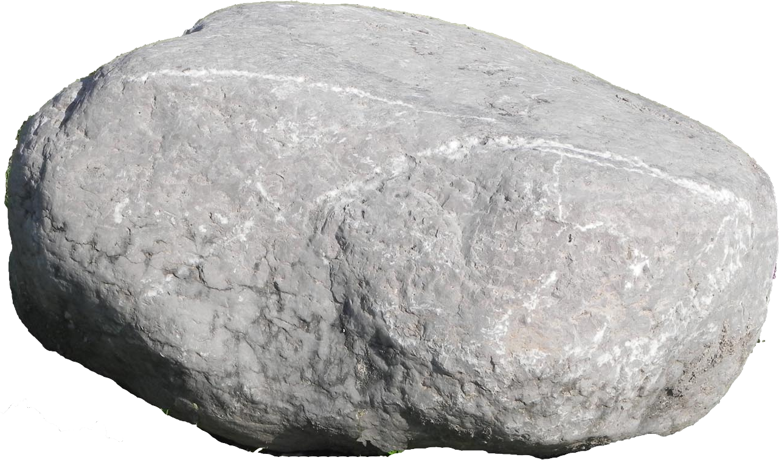

Examples of model outputs
.Correct
Y=ROCK P=ROCK
Y=PAPER P=PAPER
Y=SCISSORS P=SCISSORS
A part of this is:
Understand the Code: Before explaining the output, make sure you understand the code thoroughly. This involves reading through the code line by line and understanding what each line is doing.
.Incorrect
Y=PAPER
P=ROCK
Y=SCISSORS
P=PAPER
Y=ROCK P=PAPER
Execute the Code: Run the code in an appropriate environment, such as a code editor or an integrated development environment (IDE), to see the output produced by the code.
Analyze the Output: Once you have the output, analyze it carefully. Compare it with your expectations based on your understanding of the code.
Example of a error : ValueError : zero-size array to reduction operation maximum which has no identity

Slide 6

The highest accuracy we obtained as a combined group was a 94%. Javari is the main one to thank for this
Class | TP | FN | FP | TN | Recall | Precision | Accuracy | F1 Score | Specificity | MCC | Jaccard Index
scissor | 5 | 1 | 0 | 12 | 0.8333 | 1 | 0.9444 | 0.901 | 1 | 0.760639 | 0.8333
rock | 6 | 0 | 2 | 10 | 1 | 0.75 | 0.889 | 0.857143 | 0.833 | 0.7604 | 0.75
paper | 4 | 2 | 1 | 11 | 0.667 | 0.8 | 0.833 | 0.7273 | 0.91667 | 0.7606 | 0.5714

Slide 7

Through trial and error with Rudy Martin we found many errors that we debugged and with the help of chat gpt we made a new script of code that ran slightly better than the last.

